Slide 1
How to Build Beautiful ASP.NET MVC Apps for Non-Designers
Matt Honeycutt |@matthoneycutt
http://goo.gl/vszzGj

Slide 2
Who am I?
Software developer for the past 16 years
Hideous designer for the past 16 years
Father (of three!)
Author for Pluralsight
Blogger (trycatchfail.com)
Freelance developer

Slide 3
This talk…
WON’T…
…help you be a better designer
WILL
…help you look like a better designer

Slide 4
The importance of design
Good design!
Bad design!



Slide 5


The importance of design
Good design!
Bad design!

Slide 6



The importance of design
Apple

Slide 7
How do we do better at design?
CHEAT!

Slide 8
How do we do better at design?
“CHEAT!”

Slide 9
How do we do better at design?
Tools
Resources
Techniques

Slide 10

Tools we’ll use

Slide 11

Tools we’ll use
(the stable version)

Slide 12

Tools we’ll use

Slide 13

Tools we’ll use
(it’s like CSS, but made by people that don’t hate you!!)

Slide 14

Tools we’ll use

Slide 15

Tools we’ll use
(because if you have to clean a bathroom, you might as well have a really nice mop!)

Slide 16


Gulp in Action
STUFF THAT ACTUALLY WORKS IN A BROWSER!

Slide 17
We’re going to build a blog!

Slide 18
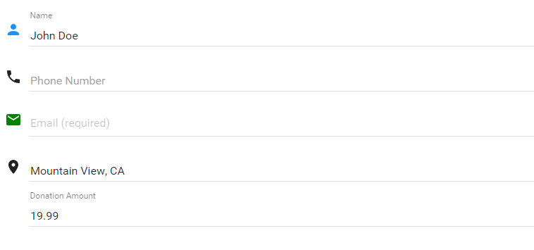
There’s no excuse for ugly business apps now…

Slide 19
Pre-requisites

Slide 20

Toolbox for the Design Impaired
Bootstrap
HUGE community
Many things “just work” with it
Responsive!

Slide 21

What will the customer say?

Slide 22

What will the customer say?

Slide 23
Bootstrap IS the problem!




Heavily used
Vanilla bootstrap is… meh
✴

It is a starting point
It is not the destination

Slide 24
Toolbox for the Design Impaired
Bootstrap
Pre-built themes
Lots of great free ones
Most are highly-compatible
Tons of great paid ones!

Slide 25
Theme Sites
Start Bootstrap
http://startbootstrap.com
Bootstrap Zero
http://www.bootstrapzero.com
Bootply
http://www.bootply.com/templates
{wrap}bootstrap
https://wrapbootstrap.com
w3 Layouts
http://w3layouts.com
Bootswatch
http://bootswatch.com

Slide 26
Toolbox for the Design Impaired
Bootstrap
Image libraries
Many great free image and icon libraries
Buying images can be reasonable, too
Pre-built themes

Slide 27
Image Libraries
pixabay
https://pixabay.com
morgueFile
http://morguefile.com
picjumbo
https://picjumbo.com
Gratisography
http://gratisography.com
fotolia
https://www.fotolia.com
Dollar Photo Club
https://www.dollarphotoclub.com
Unsplash
https://unsplash.com/
Google

Slide 28
Toolbox for the Design Impaired
Bootstrap
Pre-built themes
Image libraries
Color Pickers
You (probably) shouldn’t pick colors either!
Let color-savvy people handle this!
TONS of free tools and resources
I shouldn’t pick colors

Slide 29
Color Tools
COLOURlovers
http://www.colourlovers.com
Adobe Color Wheel
https://color.adobe.com/ create/color-wheel
Google Material Design
http://www.google.com/design/ spec/style/color.html

Slide 30
Toolbox for the Design Impaired
Bootstrap
Inspiration
I’m not creative…
… but I pay attention to creative people!
Pre-built themes
Image libraries
Color pickers

Slide 31
Inspiration
<Bootsnip>
http://bootsnipp.com
codrops
http://tympanus.net/codrops
Smashing Magazine
http://www.smashingmagazine.com/

Slide 32
“Now is a great time to be a terrible designer!” – Me, right now

Slide 33
Toolbox for the Design Impaired
Bootstrap
Pre-built themes
Image libraries
Color pickers
Inspiration

Slide 34

Want more?
Resources: http://goo.gl/vszzGj
Twitter: @matthoneycutt
Blog: http://trycatchfail.com/blog




